Slide 1
a virtual on-screen joystick input in large touch-screen devices
Mohammad Hossein Parastar

Slide 2
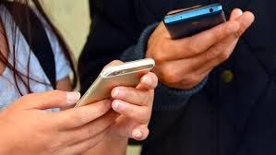
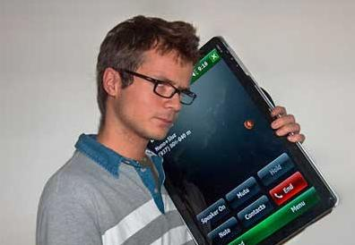
Problem
Touch screen devices getting larger
We need both hands to use them
But what should we do if our both hands not available!

Slide 3
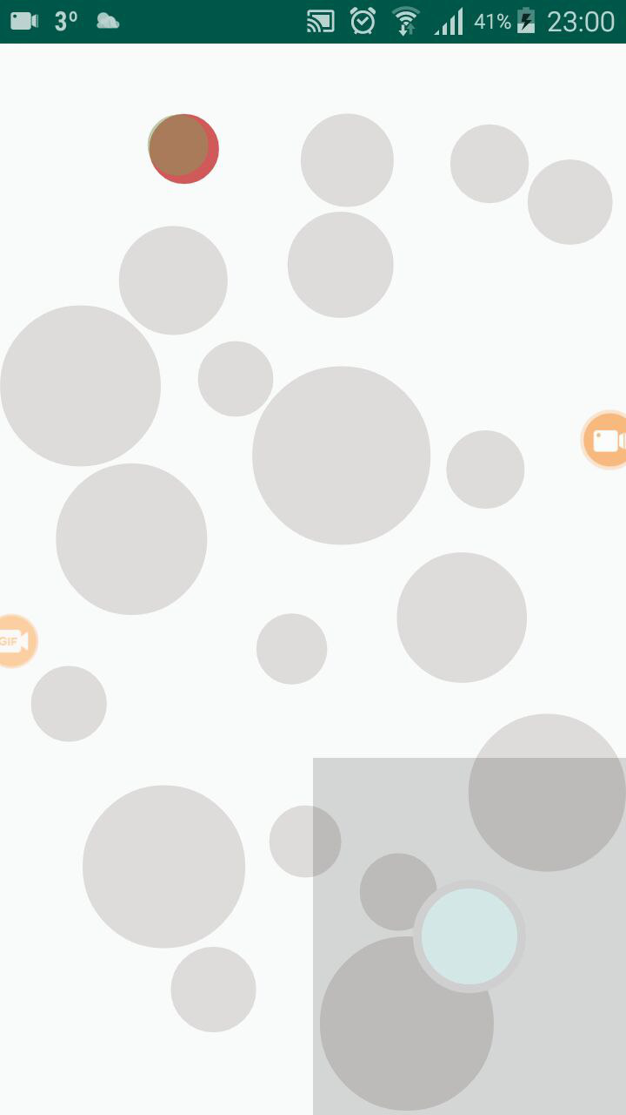
Solution
Using a small area of screen as input
Point and click on screen by a cursor
Using 3 different cursor

Slide 4
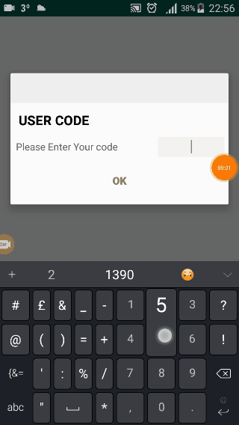
Evaluation
Participants: 8 UNB Students
Three different cursor type:
1- Small cursor
2- Large cursor with larger target
3-Bubble cursor

Slide 5
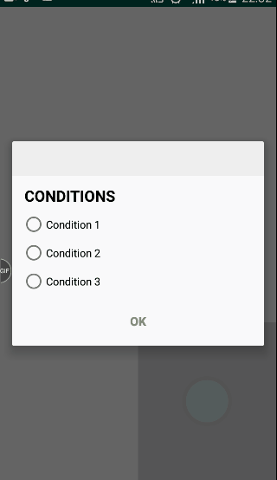
1-Small Cursor
Participants should click on 20 targeted red circles by moving the joystick-like input and double clicking for two round
Round one is for learning the technique
The circles are random in size and position
NASA-TLX questioner after each condition is done

Slide 6

2-Large Courser with larger target
Representing zoomed targets in real use since the targets are larger
Participants should click on 20 targeted red circles by moving the joystick-like input and double clicking for two round
Round one is for learning the technique
The circles are random in size and position
NASA-TLX questioner after each condition is done

Slide 7
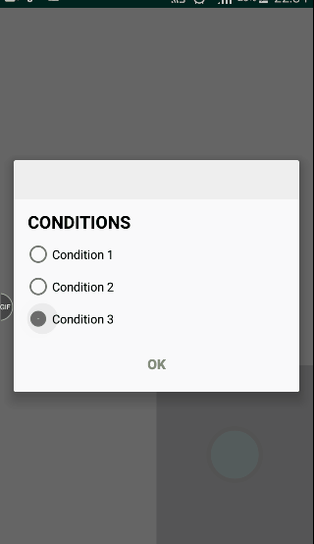
3-Bubble Cursor
The cursor size will increase until a circle in range
The pointing circle will be shown by different color
Participants should click on 20 targeted red circles by moving the joystick-like input and double clicking for two round
Round one is for learning the technique
The circles are random in size and position
NASA-TLX questioner after each condition is done

Slide 8
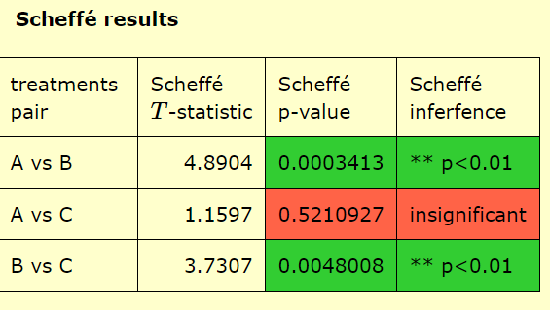
Results
T
Collected data:
Distances
Time
Errors
Target Width
Throughput calculated using the Fitts law
And analyzed by ANOVA
Result Details
Source | SS | df | MS
Between-treatments | 0.8777 | 2 | 0.4389 | F = 13.05953
Within-treatments | 0.7057 | 21 | 0.0336
Total | 1.5834 | 23
The f-ratio value is 13.05953. The p-value is .000206. The result is significant at p < .05.

Slide 10
Conclusion
Participants liked the bubble cursor
Small cursor had no error because participants tried to put the cursor inside the target circles but had highest time

Slide 11
Thank You

Slide 12
Questions?

